Slide 1





Vehicle Classification Data Analysis
Made By:
Group 103
Members:
Opeyemi Sanyaolu (30156143),
Mendjemo Ngangom Gerard Ledoux (30192835),
Kosy Onyejemezi (30189156), Chidera Awiaka (30165302)

Slide 2

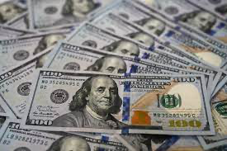
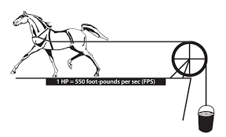
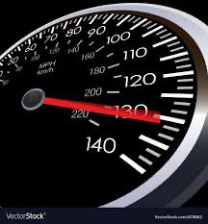
Introduction
Classification of vehicle data
Price
Make
Horsepower
Top speed

Slide 3
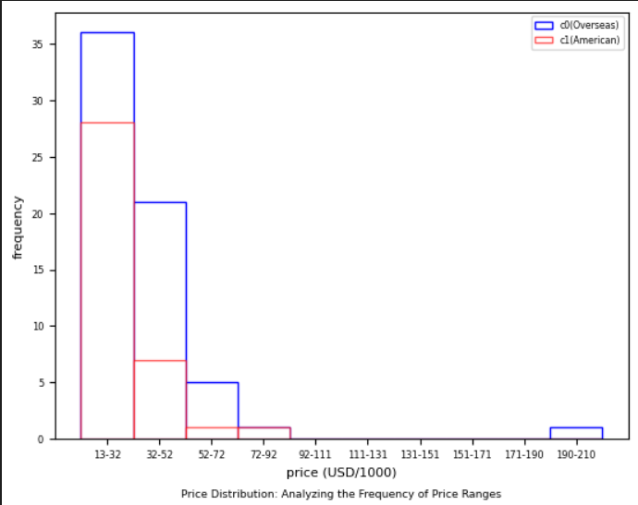

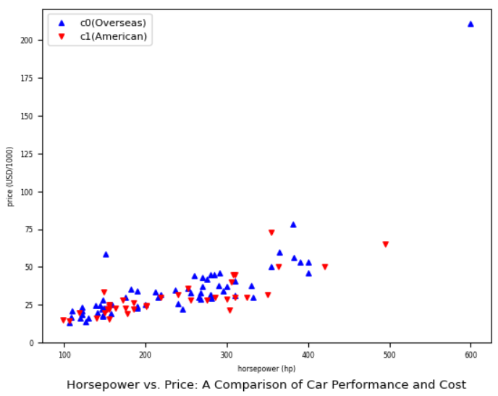
Graphical Data Analysis Pt1
Histogram:
Price vs Frequency
Overseas(blue) vs American(red)
Scatter plot:
Horsepower vs Price
Notes:
The following histogram displays how often either American made vehicles, or vehicles made overseas, appear when placed in a certain price interval. For the scatter plot, it reveals the relationship between the horsepower and the price in the cars made in America, vs the ones made overseas. The scatter plot shows that a car with a higher horsepower would usually be more expensive than one with a lower horsepower, with the cars made overseas being a bit more expensive. However, there are some exceptions as other factors could also affect the price of the car.

Slide 4

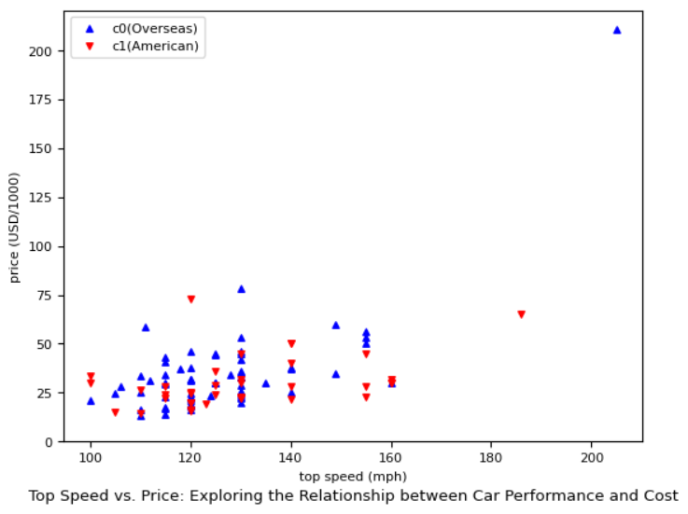
Graphical DATA Analysis pt 2
Scatter plot:
Top speed vs Price
Greater top speed does not always mean more expensive
Overseas generally more expensive
Notes:
This scatter plot reveals the correlation between the top speed and the price in the cars made in America, vs the ones made overseas. The scatter plot shows that the top speed of a car does not typically affect the price of a car the same way its horsepower does as there are many instances where cars with the same top speed have a wide range of prices. Furthermore, the cars made overseas were more expensive in comparison to the American made ones in terms of top speed.

Slide 5
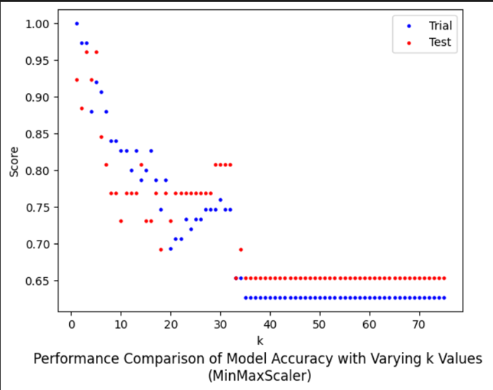
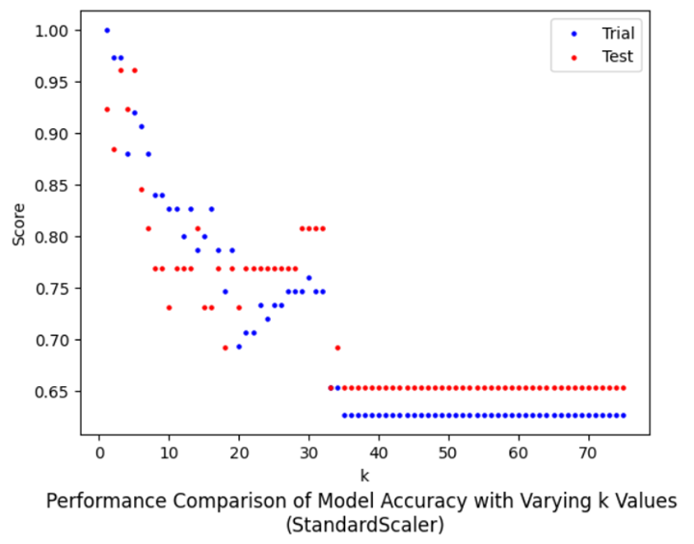
SELECTION OF K VALUE AND SCALER

Slide 6
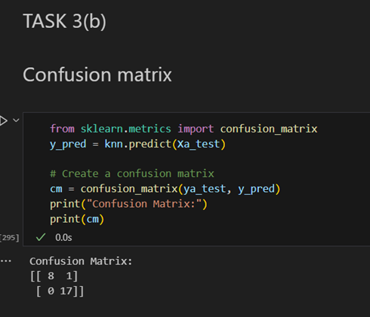
Confusion Matrix

Slide 7
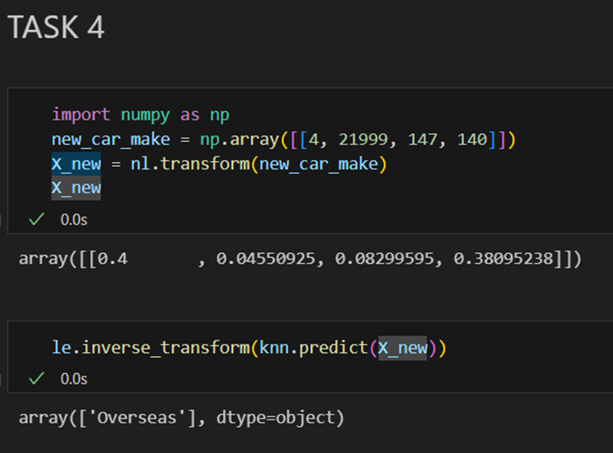
MODEL TESTING & CONCLUSION

Slide 8
References
“Cars, Trucks, SUVs, Electric Vehicles, Crossovers & Sedans | Nissan Canada,” Nissan. https://www.nissan.ca/
“Site Maintenance,” media.chevrolet.com. https://media.chevrolet.com/media/ca/en/chevrolet/our-brand.html
“Pontiac Logo and symbol, meaning, history, PNG, brand.” https://1000logos.net/pontiac-logo/
“File:Honda.svg - Wikipedia,” commons.wikimedia.org, Nov. 27, 2020. https://en.m.wikipedia.org/wiki/File:Honda.svg
Toyota logo, “Toyota logo and symbol, meaning, history, PNG,” 1000logos.net, Feb. 28, 2018. https://1000logos.net/toyota-logo/
J. Nguyen, “What would happen if paper money became obsolete?,” Marketplace, Apr. 21, 2023. https://www.marketplace.org/2023/04/21/what-would-happen-if-paper-money-became-obsolete
“Speedometer vector image on VectorStock,” VectorStock. https://www.vectorstock.com/royalty-free-vector/speedometer-vector-670882
“Understanding Horsepower and Water Horsepower | New Mexico State University - BE BOLD. Shape the Future.,” pubs.nmsu.edu. https://pubs.nmsu.edu/_m/M227/index.html
“THANKS FOR WATCHING - 20th Century Fox Tribute,” vimeo.com. https://vimeo.com/519881274

